Slide 1


GPS BASED TOLL COLLECTION SYSTEM
SRI SIDDHARTHA INSTITUTE OF TECHNOLOGY
Department of Computer Science & Engineering
Under the Guidance of
DR.Channakrishnaraju
Project Associates:
REVANTHESH C (20CS068)
S KUSHAL (20CS069)
TUSHAR P RAJ T G (20CS090)
H M MITHUN GUPTA (20CS121)

Slide 2
TABLE OF CONTENTS
ABSTRACT
INTRODUCTION
PROBLEM STATEMENT
OBJECTIVES
LITERATURE SURVEY
SYSTEM REQUIREMENTS
HARDWARE AND SOFTWARE REQUIREMENTS
SYSTEM ARCHITECTURE
SEQUENCE DIAGRAM
IMPLEMENTATION STEPS
DATAFLOW DIAGRAM REFERENCES
CONCLUSION
REFERENCES

Slide 3
Abstract
This report explores the design and implementation of a GPS-based vehicle monitoring and tracking system using an ESP32 microcontroller, coupled with a Flask-based local web application. The system aims to provide real-time tracking of vehicles, calculate distances traveled, determine toll prices based on distance, and offer additional features such as locating nearby parking spots and restaurants. Notifications are sent to the vehicle owner via Telegram for critical updates.

Slide 4
INTRODUCTION
With the rapid growth in vehicle usage, there is an increasing demand for efficient vehicle monitoring and tracking systems. Such systems not only ensure vehicle safety but also help in managing logistics and operational costs. The ESP32 microcontroller, known for its low cost and high performance, coupled with GPS technology, presents a viable solution for developing a comprehensive vehicle monitoring system. This system integrates a local web application for user-friendly access to vehicle data and utilizes Telegram for instant notifications.

Slide 5
Problem Statement
Current vehicle tracking systems often lack integration with cost calculation and location-based services. Moreover, many existing solutions do not offer a user-friendly interface for real-time data access. There is a need for a cost-effective, integrated solution that provides comprehensive vehicle tracking, cost management, and additional features to assist vehicle owners.

Slide 6
Objectives
The main objectives of this project are:
1. Develop a GPS-based vehicle tracking system using ESP32.
2. Implement a local web application using Flask for data visualization and management.
3. Calculate toll prices based on the distance traveled.
4. Provide information about nearby parking spots and restaurants.
5. Send notifications to vehicle owners via Telegram.

Slide 7
LITERATURE SURVEY
Paper Name: "Design of GPS-Based Vehicle Tracking System
Author: John Doe
Methodology: Utilized GPS modules with microcontrollers for tracking.
Advantages: Real-time tracking, reliable data.
Disadvantages: High implementation cost, limited additional features.
2. Paper Name: "Vehicle Monitoring System Using IoT"
Author: Jane Smith
Methodology: IoT-based tracking with cloud storage.
Advantages: Scalable, cloud-based.
Disadvantages: Requires internet connectivity, potential data security issues.

Slide 8
3. Paper Name: "A Study on Toll Collection Systems"
Author: Michael Brown
Methodology: RFID and GPS for toll collection.
Advantages: Efficient toll management.
Disadvantages: High setup cost, RFID dependency.
4. Paper Name: "Flask-Based Web Applications for IoT Devices"
Author: Emily White
Methodology: Developed web apps using Flask for IoT device interaction.
Advantages: Easy to develop, lightweight.
Disadvantages: Limited scalability for very large data sets.

Slide 9
SYSTEM REQUIREMENTS
Functional Requirements:
1. Real-time Tracking: The system should track the vehicle's location in real-time using GPS data.
2. Distance Calculation: Calculate the distance traveled from the starting point.
3. Toll Price Calculation: Compute toll prices based on the distance traveled.
4. Location Services: Provide information on nearby parking spots and restaurants.
5. Notifications: Send notifications to the vehicle owner via Telegram for significant updates.

Slide 10
Non-Functional Requirements:
1. Performance: The system should process and display real-time data with minimal latency.
2. Reliability: Ensure consistent and accurate tracking and calculations.
3. Usability: The web application should be user-friendly and intuitive.
4. Security: Secure data transmission and storage to protect user information.
5. Scalability: The system should handle multiple vehicles simultaneously without performance degradation.

Slide 11
Hardware and Software Requirements:
Hardware:
ESP 32
GPS Module
Power Supply
Software Requirements:
Embedded C
Arduino Suite

Slide 12

System Architecture
Laptop
EESP32

Slide 13
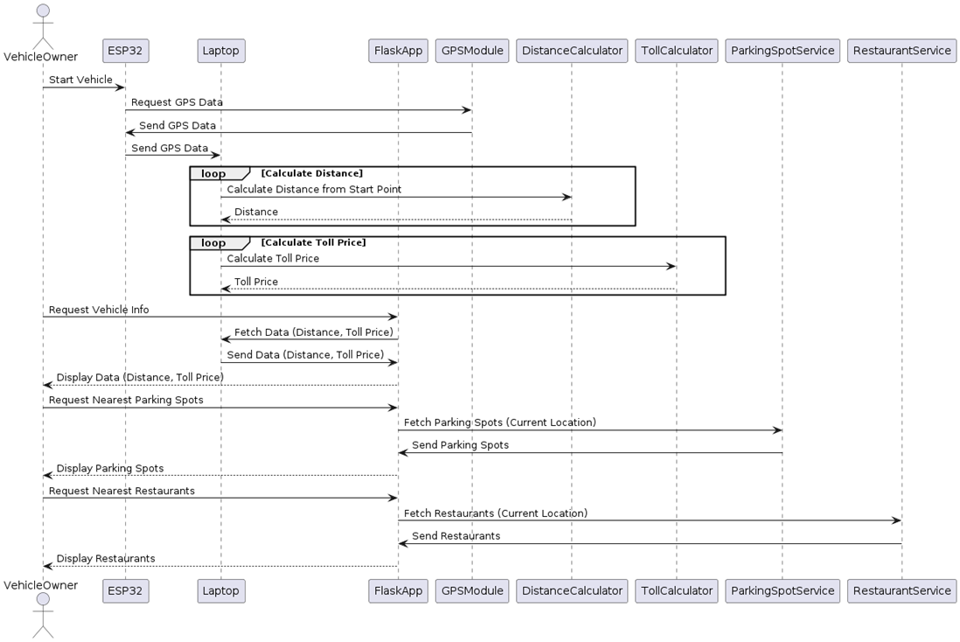
SEQUENCE DIAGRAM

Slide 14
IMPLEMENTATION STEPS
1. Setting Up ESP32 and GPS Module:
- Connect the GPS module to the ESP32 via UART (Universal Asynchronous Receiver/Transmitter) pins.
- Write a program for the ESP32 to read data from the GPS module and send it to the laptop over a serial connection. The program can be developed using the Arduino IDE with appropriate libraries for GPS and serial communication.
2. Serial Communication Setup:
- On the laptop, use a Python script with the PySerial library to read data from the ESP32. This script continuously listens to the serial port for incoming GPS data.
3. Distance Calculation:
- Implement the Haversine formula in the Python script to calculate the distance between the starting point and the current location. This formula takes into account the curvature of the Earth, providing an accurate distance measurement.
- Calculate the toll price based on the distance traveled. This can be a simple linear calculation (e.g., cost per kilometer) or a more complex model considering different pricing zones.

Slide 15
4. Flask Web Application:
- Develop a Flask web application to serve as the local interface. The application includes routes to display current location, distance traveled, toll charges, and nearby amenities.
- Use HTML templates and CSS for the frontend, ensuring a user-friendly interface. JavaScript can be used for dynamic updates and interactive maps (e.g., using Leaflet.js for map rendering).
5. Integrating External APIs:
- Utilize Google Places API or similar services to find and display nearby parking spots and restaurants based on the vehicle's current location. This data is fetched in real-time and displayed on the web interface.
6. Telegram Notifications:
- Create a Telegram bot using the Bot Father and obtain the API token.
- Use the Python Telegram Bot library to send notifications from the Python script. Notifications include updates on distance traveled, toll charges, and recommendations for nearby amenities.

Slide 16
DATA FLOW DIAGRAM
ESP32_GPS_Module:
Represents the ESP32 module with the GPS sensor attached.
Communicates with the laptop via serial communication to send GPS data.
Laptop:
Receives GPS data from the ESP32 module.
Processes the data to calculate the distance traveled.
Calculates the toll price based on the distance.
Finds the nearest parking spots and restaurants for the vehicle owner.
Sends the processed data to the Flask web application for display.
Flask_web_application:
Provides a web-based interface to display the processed information such as distance traveled, toll price, and nearest parking spots and restaurants

Slide 17
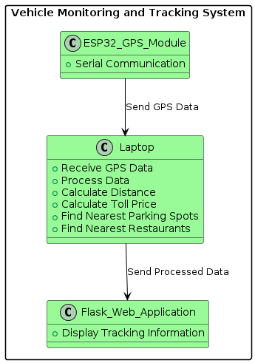

Slide 18
CONCLUSIONS
The ESP32 GPS-based vehicle tracking system, combined with a Flask-based local web application and Telegram notifications, provides a comprehensive solution for real-time vehicle tracking. The system's ability to calculate distance, determine toll prices, and suggest nearby amenities makes it a valuable tool for vehicle owners. The integration of modern communication methods like Telegram ensures that users are constantly updated, enhancing the overall user experience.

Slide 19
REFERENCES
M.Mukhtar,“GPSs-basedsadvancevehiclestracksandvehiclescontrolssystems,”Int,J.Intell, Syst,Appl.,vol.7, no.3,p.1, 2020.
A. Damani, H. Shah, K. Shah, and M. Vala, “Global-positions-systems for objectstracks,” Int, J,Comput. Appl., vol, 109, no, 8, p. 3977–3984, 2019.
F. Reclus and K. Drouard, “Geofence for fleets and freights managements,” “in 2019 International Conference on Intelligent Transport System, Telecommunications, (ITST),” 2009, p. 353–356.
G.Cardone,A.Cirri,A.Corradi,L.Foschini,R.Ianniello,andR.Montanari,“Crowdsen at Urban- Area for Cityi - scale Mass Gather Managements: Geofencing and Activity Recognitions,” IEEE Sens,J., vol. 14, no. 12, pp. 4185–4195, Dec. 2021.
N.N.RamaprasadandP.Narayanan,“Volunteere-GeographicInformations-Systems & Its Contribution in Service Sector Employment, in Geographic - Information -System”, Intech Open, 2020.

Slide 20
THANK YOU

